Slide 1
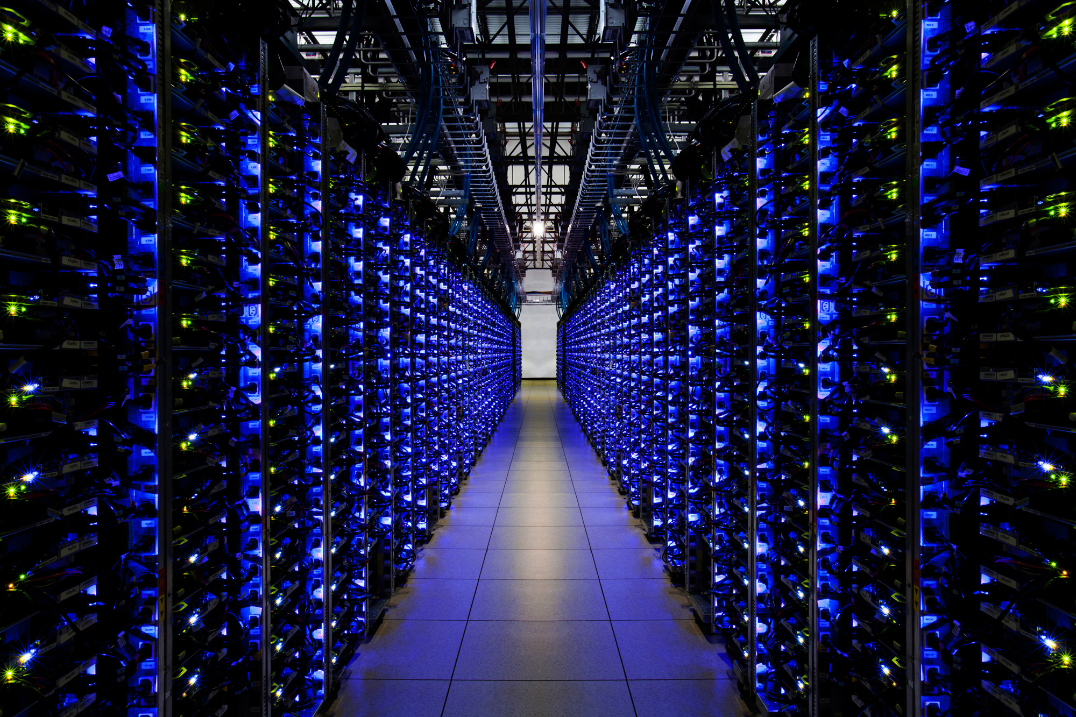

BNVirt

Slide 2

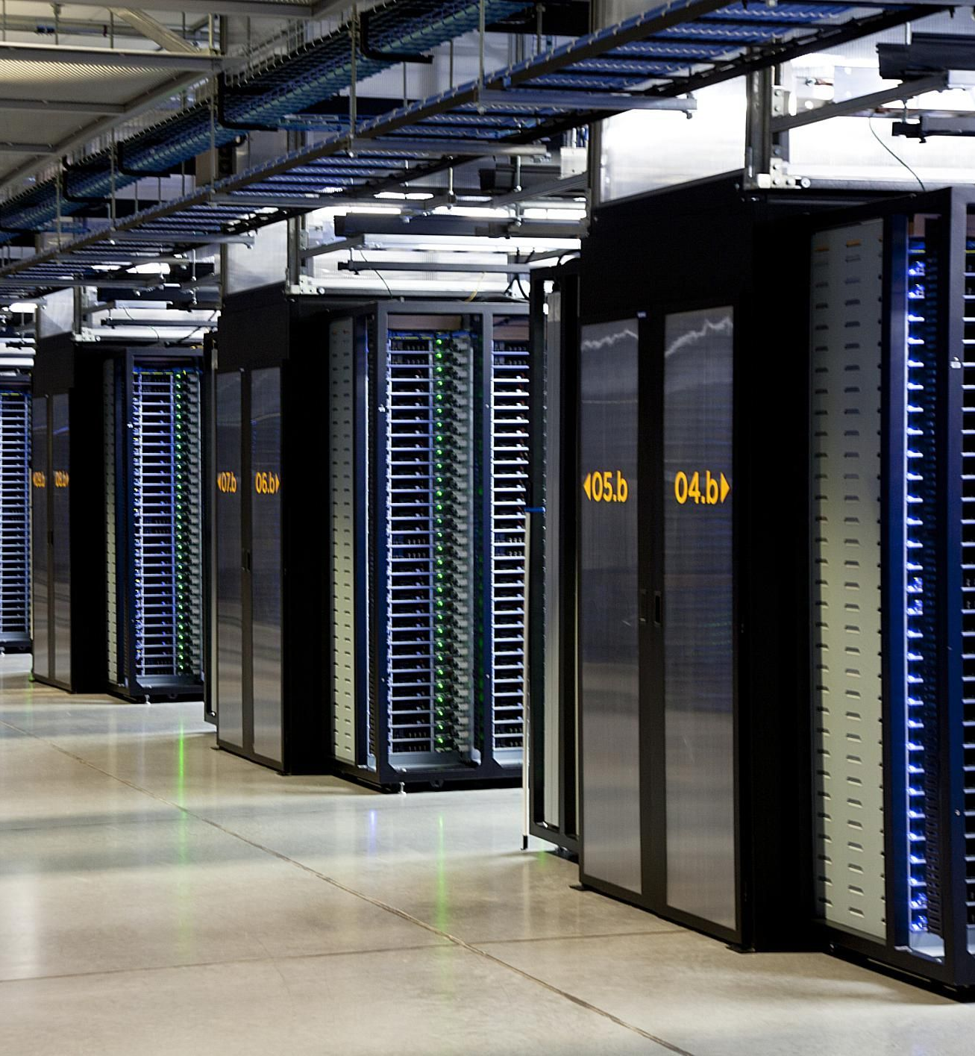
Providing Infrastructure to Tenants/Customers
BNVirt

Slide 3

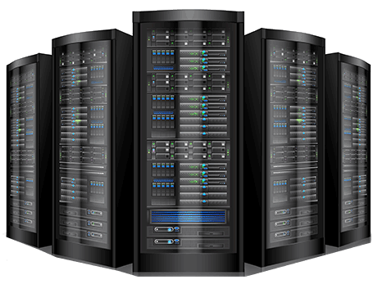

Providing Infrastructure to Tenants/Customers
Renting Dedicated Servers and Switches
IaaS Cloud Provisioning
Virtual Machines
Bare-Metal
BNVirt

Slide 4
Option 1:
Dedicated switching fabric
per customer.
Problems:
1) High Cost (Capex).
2) High Maintenance (Opex).
3) High Deployment/ Teardown Time.
4) Manual Configuration & Cabling
BNVirt

Slide 5
Providing Infrastructure to Tenants/Customers
Renting Dedicated Servers and Switches
IaaS Cloud Provisioning
Virtual Machines
Bare-Metal
BNVirt

Slide 6
Option 2:
VM (Virtual Machines) -Based Solution (E.g. OpenStack, AWS etc.)
Problems:
1) Lack of Performance guarantees.
2) Lack of Security guarantees.
3) Customers may require
dedicated infrastructure :
a) Regulatory reasons.
b) Predictable performance.
4) Customers may require Container/VM Deployments.
BNVirt

Slide 7
Providing Infrastructure to Tenants/Customers
Renting Dedicated Servers and Switches
IaaS Cloud Provisioning
Virtual Machines
Bare-Metal
BNVirt

Slide 8

BNVirt

Slide 9
What is Bare-Metal? Why Bare-Metal?
BNVirt
Notes:
Motivate Bare-metal with some example cases :
Finance, or side-channel attacks on vm.
News articles which focus on that.
Popularity of containers.

Slide 10

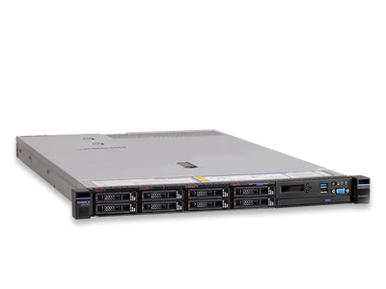



“Worldwide Bare Metal Cloud Market to Grow at a CAGR of 43.2% during 2016-2022 to aggregate $9150.3 million by 2022”. – Research & Markets
Bare-Metal cloud services are increasing due to following:
Data-Isolation & Privacy concerns.
Regulatory Reasons.
Performance Guarantees for applications such
as Big-Data, Deep Learning and container micro services.
BNVirt

Slide 11
IaaS Landscape
IaaS providers until now have been provisioning Servers not Switches.
Switches are an essential part of infrastructure.
Enforce Policies.
Performance Tuning.
With BNVirt, we provision not only servers but also switches.
= IaaS + Programmable Switching Fabric.
BNVirt
BNVirt

Slide 12
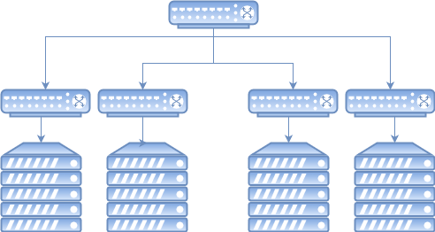
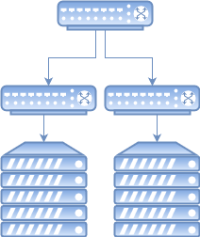
BNVirt

Slide 13
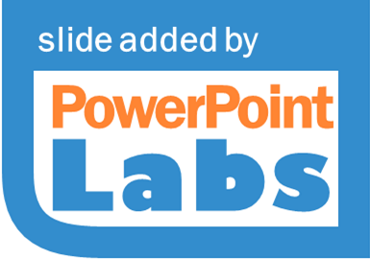
BNVirt

Slide 14



Tenant1
Tenant 2
Tenant 3)
OpenDaylight Controller
ONOS Controller
POX Controller
Virtual Topology
Tenant 1
BNVirt
Virtual Topology
Virtual Topology
Tenant 2
Tenant 3
BNVirt

Slide 15
Tenant 2
Tenant1
Tenant 2
Tenant 3
Virtual Topology
Virtual Topology
Virtual Topology
BNVirt
Tenant 1
Tenant 3
BNVirt

Slide 16
Tenant 2
Tenant1
Tenant 2
Tenant 3
Virtual Topology
Virtual Topology
Virtual Topology
BNVirt
Tenant 1
Tenant 3
All the virtual topologies are running on the actual physical switching fabric
BNVirt

Slide 17
Tenant 2
Tenant1
Tenant 2
Tenant 3
Virtual Topology
Virtual Topology
Virtual Topology
BNVirt
Tenant 1
Tenant 3
BNVirt

Slide 18

Guarantee Isolation/ Sandbox
Flexible Hardware accelerated Topologies with Bare-metal Switching.
Low Cost and Easy to provision.
Software Defined Networking to Customers.
Tenant 2
Tenant1
Tenant 2
Tenant 3
Virtual Topology
Virtual Topology
Virtual Topology
BNVirt
Tenant 1
Tenant 3
BNVirt

Slide 19



Milestones
Step 1
Industry Discussions:
1) Interacted with people from Microsoft, VMWare, Cisco, and also an ISP.
Takeaway:
Demonstrations needed.
Visualization of Topologies.
Building services on top of this.
Technical Milestones:
Surveyed various bare-metal services.
Made BNVirt, a stand-alone provisioning service.
Planned to use SmartNIC for BNVirt
1) Deployment in NCL
( National Cybersecurity Lab)
Will be used by research groups in NUS, A-Star and SUTD.
2) Filed Provisional Patent

Slide 20
Fund Usage
Registered Domain (Cerebell.net)
Placeholder Website.
Procurement of SmartNICs ( ~1500SGD)
In Progress:
UI/UX Design (2000 – 3000 SGD).
Procurement of Two workstations. (~5000 SGD)

Slide 21

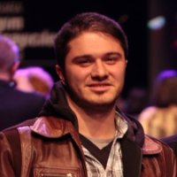

Ahmad SOLTANI
Pravein Govindan Kannan
BNVirt

